Slide 1
SATs MEETING
Class 5 2026

Slide 2
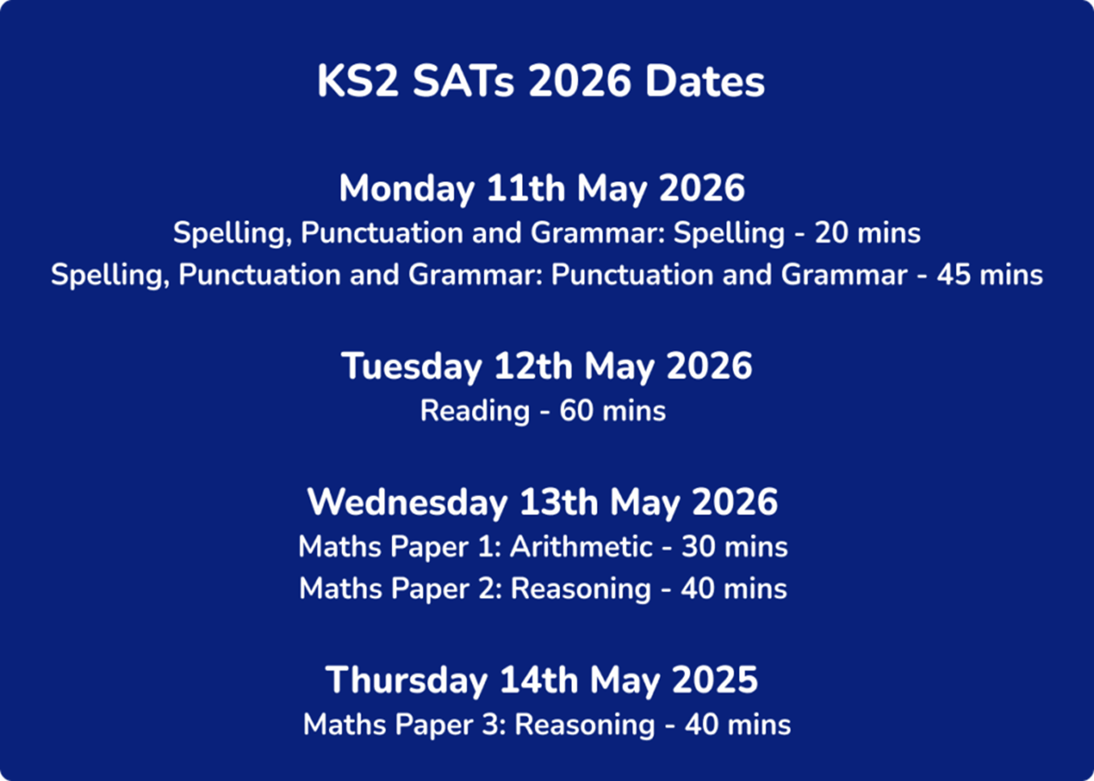
When and what are the SATs?
National curriculum assessments for Year 6 pupils to help measure progress at the end of KS2
Teacher judgements are used to assess
English: Writing
Science
We will have a Forest School session on either Thursday after the last one, or on the Friday.

Slide 3
GPS: our current practice
Class 5 mostly stays together for spelling work and works through all Y5 and Y6 spellings (intro – activity – handwriting – test)
Specific difficulties with spelling are addressed through small group intervention
Grammar-based lesson starters (in addition to this being a writing focus and further explored in reading)
Grammar-based homework
Past papers (half-termly) and review

Slide 4
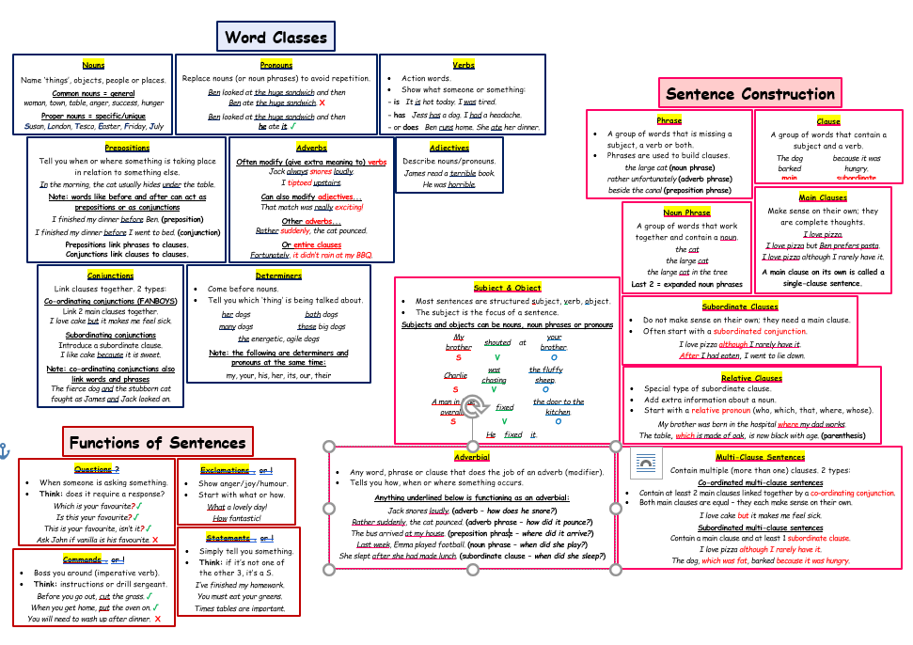
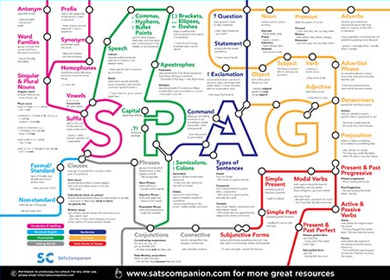
What do they need to know?
NC - spelling curriculum: https://assets.publishing.service.gov.uk/media/5a7ccc06ed915d63cc65ce61/English_Appendix_1_-_Spelling.pdf
Y6 Spelling overview at Birch: https://www.birch.essex.sch.uk/page/?title=Spellings&pid=76
Please feel free to take a copy

Slide 5
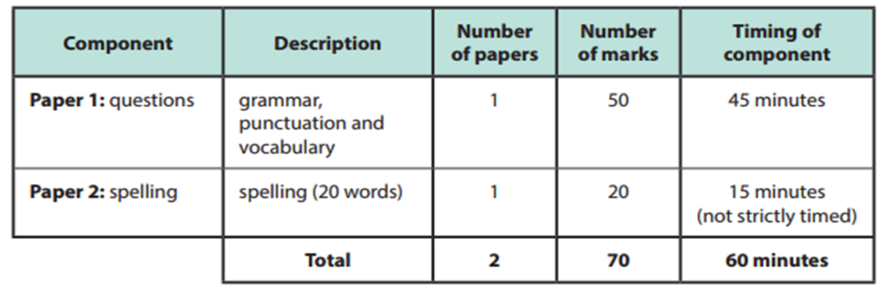
GPS papers:

Slide 6
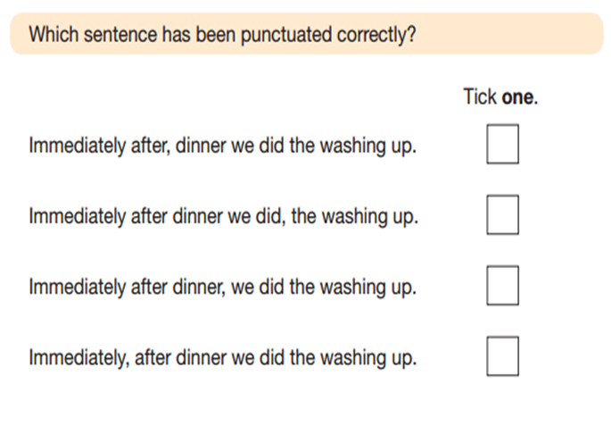
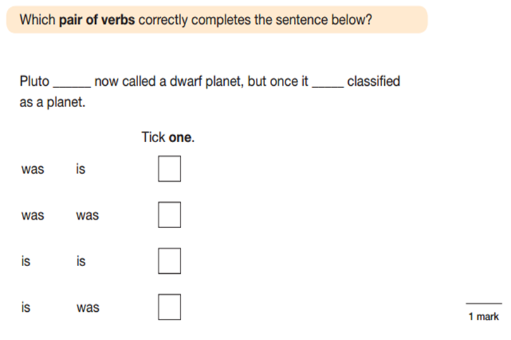
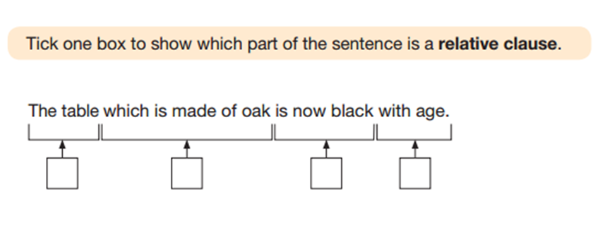

Slide 7
Reading: our current practice
Individual reading with class teacher
Additional, ‘regular reading’ with specific pupils
Reading curriculum x 2 sessions per week (key skills, book club etc.)
Class book
Reading for pleasure – quiet reading, Shepherd’s Hut
Book buddies with Class 1
Book Café resources
Class library
School library
Past papers (half-termly) and review
Home reads

Slide 8
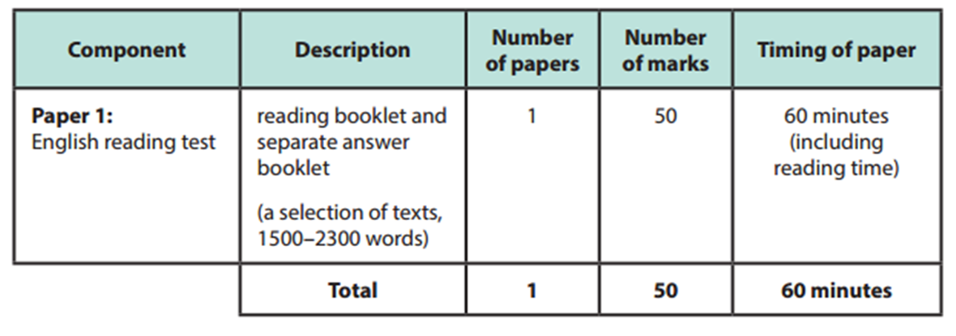
English: Reading paper

Slide 9
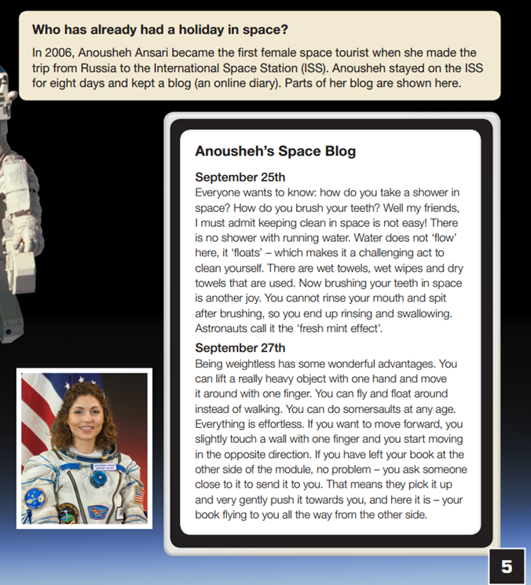
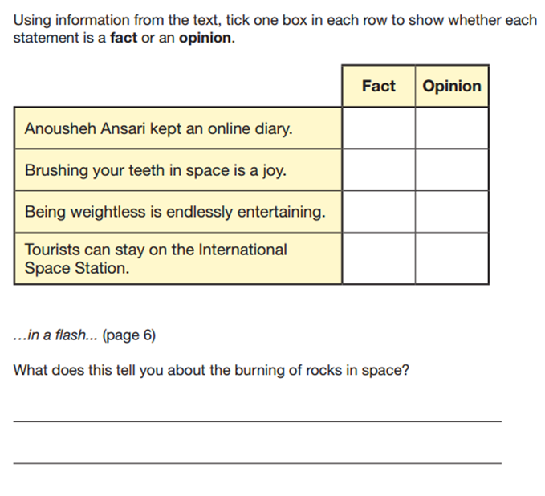

Slide 10
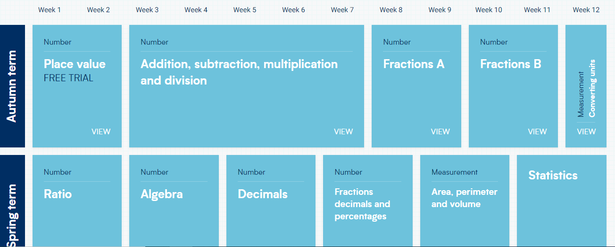
Maths Overview

Slide 11
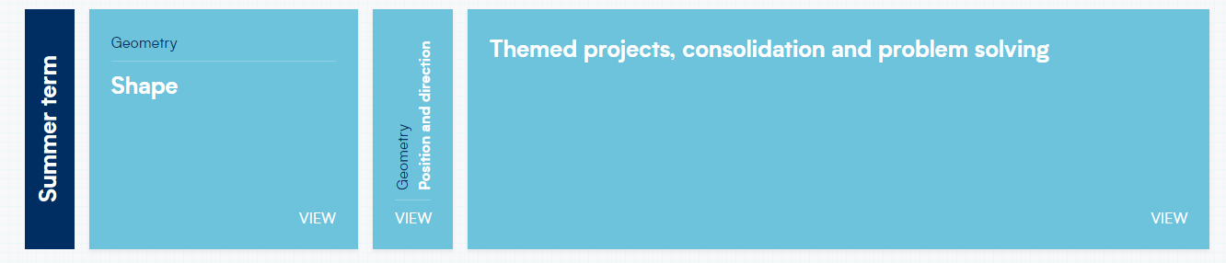
Please have a look at our calculation policy:
https://primarysite-prod-sorted.s3.amazonaws.com/birchchurch/UploadedDocument/e4141568-a289-47cc-aa26-489d883f48d2/wrm-calculation-policy-2024-all-year-groups.pdf

Slide 12
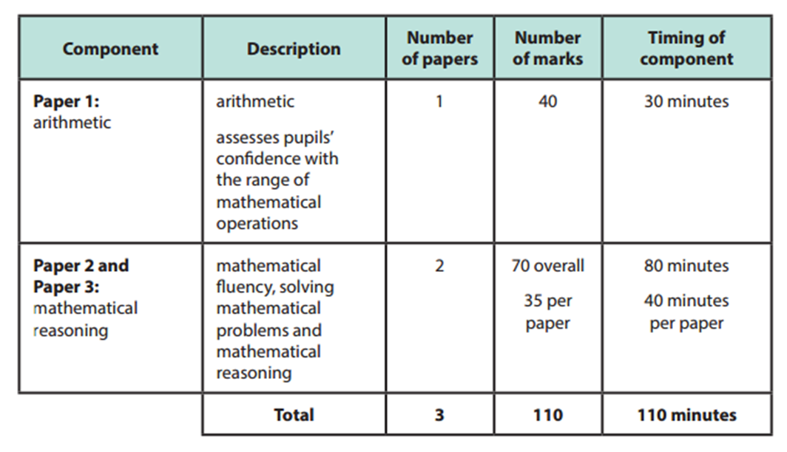
Maths papers

Slide 13
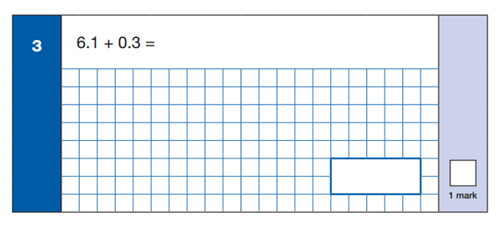
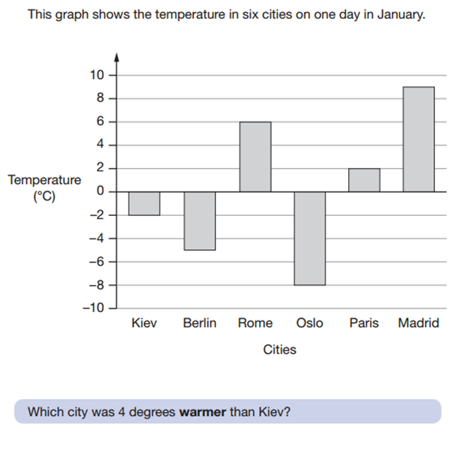
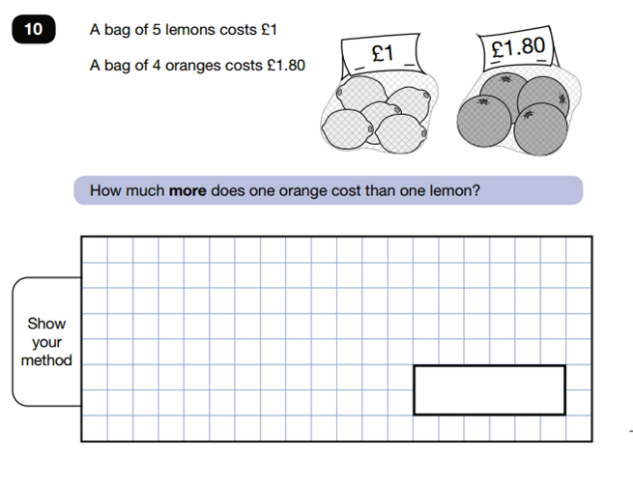
Have a look through...
Please note past papers are available online, including mark schemes and scaled scores
https://www.satspapers.org.uk/

Slide 14
MATHS REVISION SESSIONS...
Currently, Mrs May delivers extra support maths sessions to specific pupils before school on Tuesdays and Wednesdays.
Last year, there were also Friday sessions for all pupils before school, with a reasoning focus in Spring term 2. Then also Tuesdays, Wednesdays and Fridays in the 3 weeks leading up to the tests in Summer term 1.

Slide 15
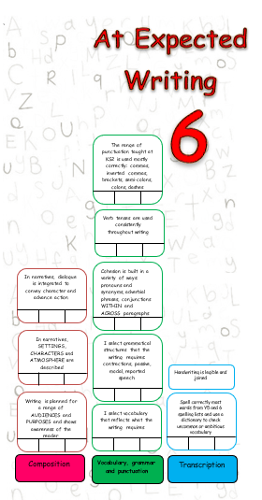
Writing: Teacher Assessment
Levels within Y6 curriculum:
Working towards
At Expected
At Greater Depth
Teacher assessment framework:
https://assets.publishing.service.gov.uk/media/637ba0b0e90e072854bcab87/2018-19_teacher_assessment_frameworks_at_the_end_of_key_stage_2.pdf
Birch Year 6 writing targets

Slide 16
What happens post-SATs?
Maths curriculum to finish and secure. All other areas continue as usual.
Writing: gather final pieces of evidence for assessment
Enrichment: Crucial Crew/Castle Park visit, fundraising event, Agents of Change, School Fete, transition work/PSHE, inductions, sports events, Sports Day, Summer Show, Moving On Camp, Leavers’ assembly…

Slide 17
Thank you for your time.
Any questions?

