Slide 1
Mastering Number
Mastering Number helps secure firm foundations in the development of good number sense. The aim is that children leave KS1 with fluency in calculation.
Research shows children with secure number sense early on make more progress later.
https://www.ncetm.org.uk/maths-hubs-projects/mastering-number-at-reception-and-ks1/

Slide 2
What is Mastering Number?
It is a 10-15 minute daily fluency session for approx. 30 weeks of the academic year.
• In Key Stage 1 the Mastering Number programme is in addition to the main maths lesson.

Slide 3
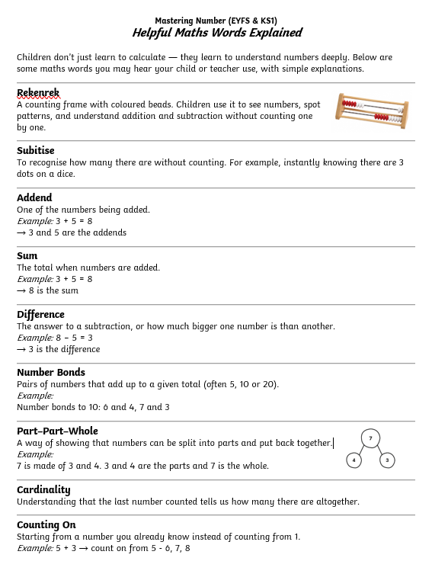
Mastering Number (EYFS & KS1)
Helpful Maths Words Explained
Children don’t just learn to calculate — they learn to understand numbers deeply. Below are some maths words you may hear your child or teacher use, with simple explanations.

Slide 4
Mastering Number
This week looks at how numbers 11-19 can be composed of ‘10 and a bit’.
A range of representations are used including the Numberblocks, double dice frames, part-part-whole diagrams and the rekenrek.
Year 2
Term 1
Week 10
Focus: Composition

Slide 5
Session 1
Mastering Number 2021/22 ncetm.org.uk

Slide 6
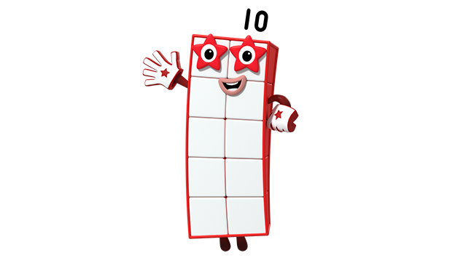
Hello! I am Ten!
Image © 2021 Alphablocks Ltd. All rights reserved. Mastering Number 2021/22 ncetm.org.uk

Slide 7
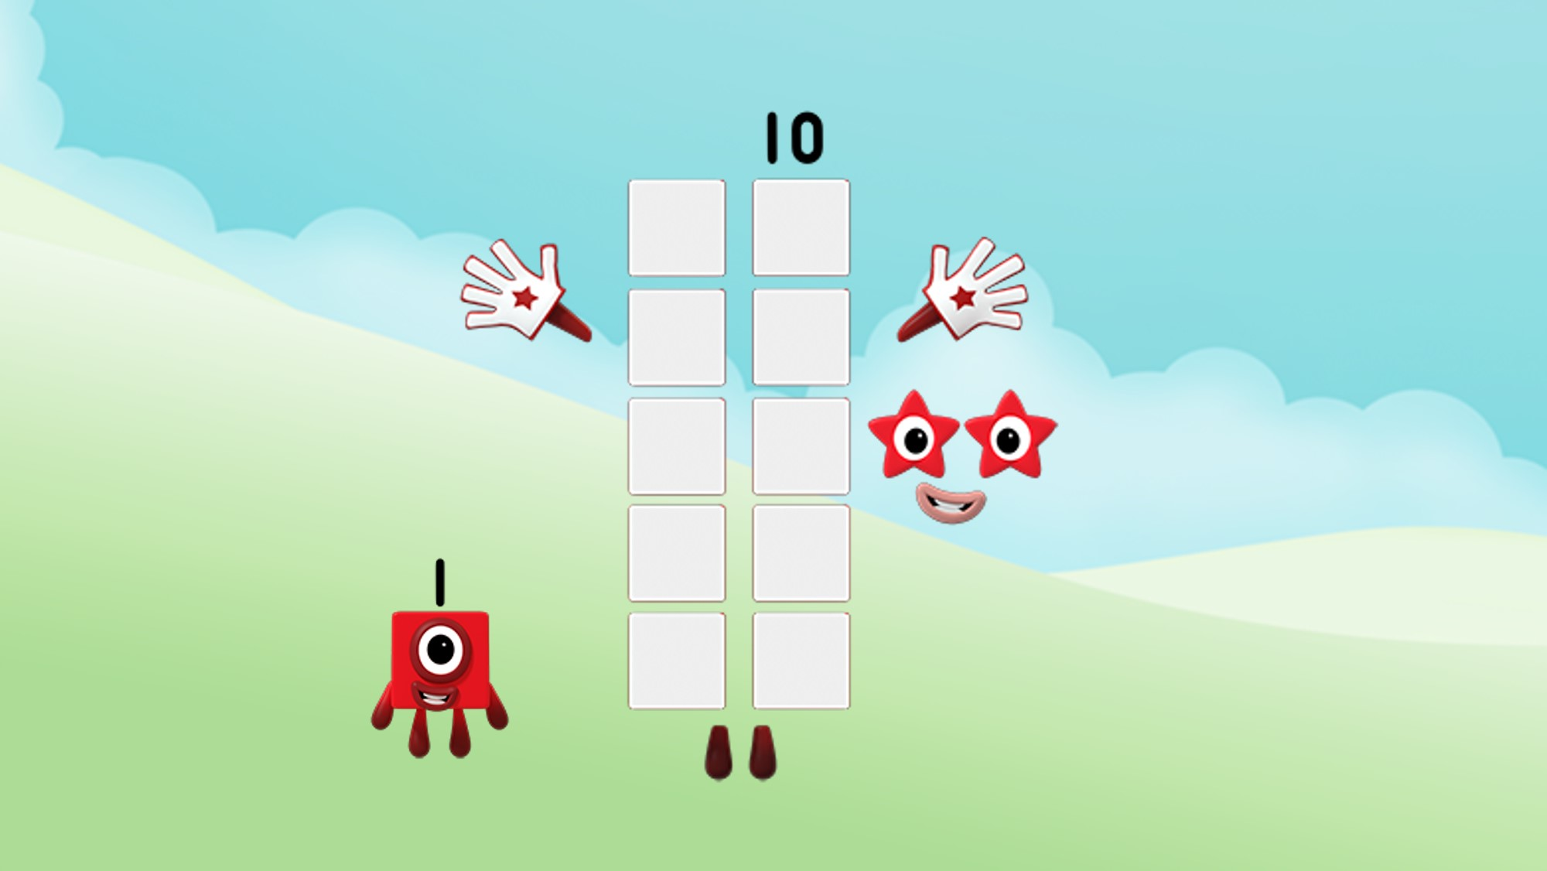
You can say I am ten 1s!
Image © 2021 Alphablocks Ltd. All rights reserved. Mastering Number 2021/22 ncetm.org.uk

Slide 8
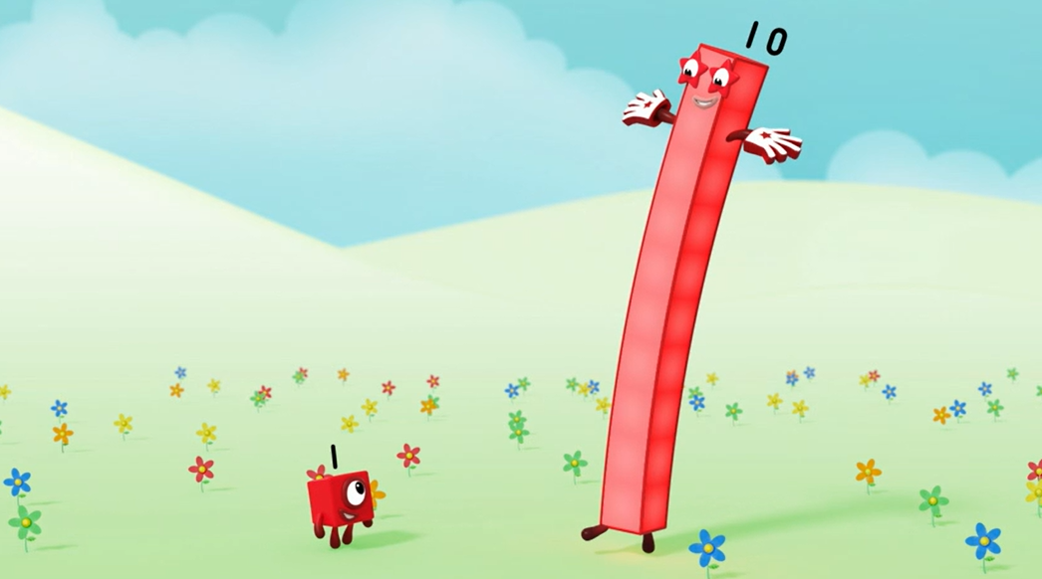
Look at the faces of a dice. Find one in your home or on the internet. What do you notice?
You can say I am one 10!
Image © 2021 Alphablocks Ltd. All rights reserved. Mastering Number 2021/22 ncetm.org.uk

Slide 9
I can also be a part of other numbers!
Image © 2021 Alphablocks Ltd. All rights reserved. Mastering Number 2021/22 ncetm.org.uk

Slide 10
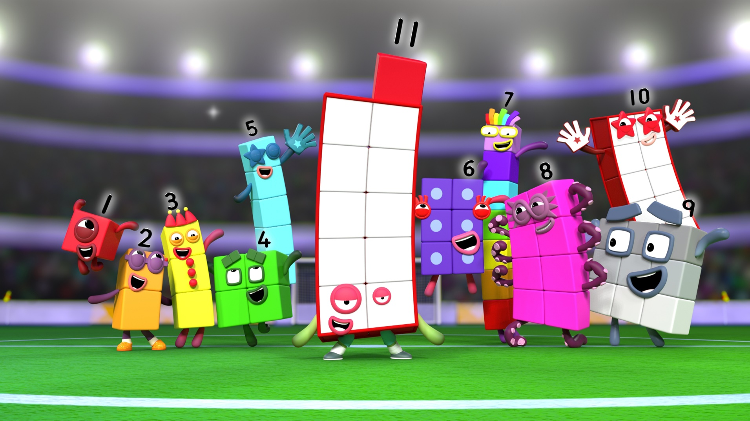
Numberblocks
Series 3, Episode 21: Eleven
Video © 2021 Alphablocks Ltd. All rights reserved. Mastering Number 2021/22 ncetm.org.uk

Slide 11
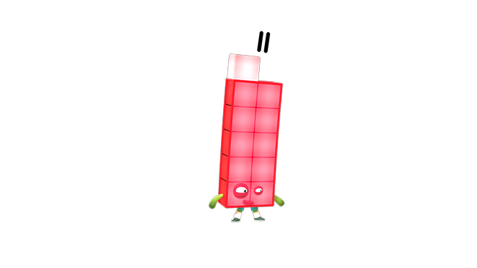
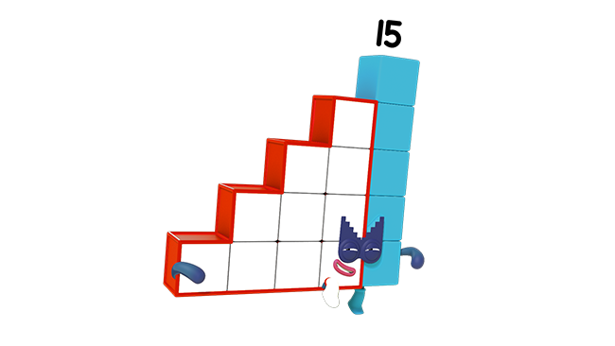
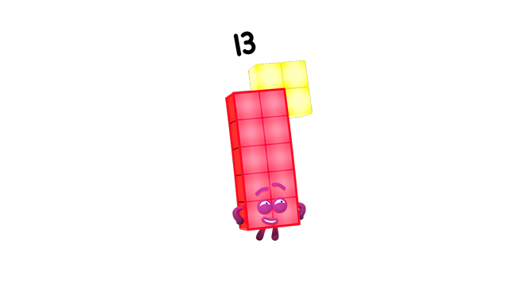
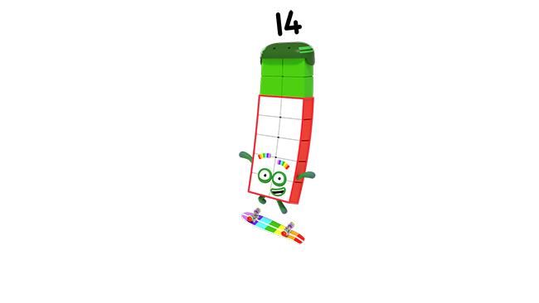
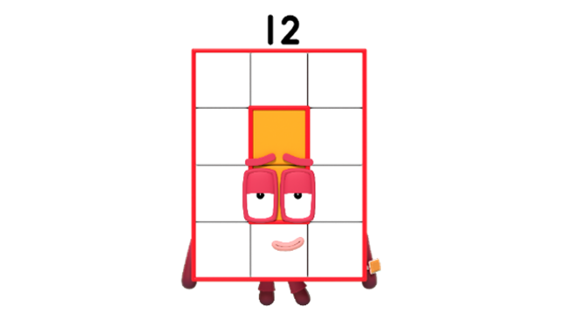
Can you see that 10 is a part of me and my friends?
Images © 2021 Alphablocks Ltd. All rights reserved. Mastering Number 2021/22 ncetm.org.uk

Slide 12
Use your rekenrek to help you say what 10 needs to make other numbers!
Image © 2021 Alphablocks Ltd. All rights reserved. Mastering Number 2021/22 ncetm.org.uk

Slide 13
Make each number using all the beads on the top row
10 needs _____ to make _____ ;
_____ is made of 10 and _____ .
Image © 2021 Alphablocks Ltd. All rights reserved. Mastering Number 2021/22 ncetm.org.uk

Slide 14
10 needs _____ to make _____ ;
_____ is made of 10 and _____ .
Image © 2021 Alphablocks Ltd. All rights reserved. Mastering Number 2021/22 ncetm.org.uk

Slide 15
10 needs _____ to make _____ ;
_____ is made of 10 and _____ .
Image © 2021 Alphablocks Ltd. All rights reserved. Mastering Number 2021/22 ncetm.org.uk

Slide 16
10 needs _____ to make _____ ;
_____ is made of 10 and _____ .
Image © 2021 Alphablocks Ltd. All rights reserved. Mastering Number 2021/22 ncetm.org.uk

Slide 17
10 needs _____ to make _____ ;
_____ is made of 10 and _____ .
Image © 2021 Alphablocks Ltd. All rights reserved. Mastering Number 2021/22 ncetm.org.uk

Slide 18
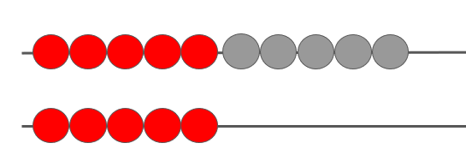
How can we ‘see’ 10 and 5 in 15?
10
5
10
5
Mastering Number 2021/22 ncetm.org.uk

Slide 19
Session 2
Mastering Number 2021/22 ncetm.org.uk

Slide 20
Make each number using all the beads on the top row
10 needs _____ to make _____ ;
_____ is made of 10 and _____ .
Image © 2021 Alphablocks Ltd. All rights reserved. Mastering Number 2021/22 ncetm.org.uk

Slide 21
10 needs _____ to make _____ ;
_____ is made of 10 and _____ .
Image © 2021 Alphablocks Ltd. All rights reserved. Mastering Number 2021/22 ncetm.org.uk

Slide 22
10 needs _____ to make _____ ;
_____ is made of 10 and _____ .
Image © 2021 Alphablocks Ltd. All rights reserved. Mastering Number 2021/22 ncetm.org.uk

Slide 23
10 needs _____ to make _____ ;
_____ is made of 10 and _____ .
Image © 2021 Alphablocks Ltd. All rights reserved. Mastering Number 2021/22 ncetm.org.uk

Slide 24
10 needs _____ to make _____ ;
_____ is made of 10 and _____ .
Image © 2021 Alphablocks Ltd. All rights reserved. Mastering Number 2021/22 ncetm.org.uk

Slide 25
How did we ‘see’10 and 5 in 15?
10
5
10
5
Mastering Number 2021/22 ncetm.org.uk

Slide 26


Make the same number on your rekenrek
_____ is made of 10 and _____ ;
10 and _____ make _____ .
Mastering Number 2021/22 ncetm.org.uk

Slide 27
_____ is made of 10 and _____ ;
10 and _____ make _____ .
Mastering Number 2021/22 ncetm.org.uk

Slide 28
_____ is made of 10 and _____ ;
10 and _____ make _____ .
Mastering Number 2021/22 ncetm.org.uk

Slide 29
_____ is made of 10 and _____ ;
10 and _____ make _____ .
Mastering Number 2021/22 ncetm.org.uk

Slide 30
Session 3
Mastering Number 2021/22 ncetm.org.uk

Slide 31
Let’s use my dice pattern to make numbers!
What if you had another frame?
Image © 2021 Alphablocks Ltd. All rights reserved. Mastering Number 2021/22 ncetm.org.uk

Slide 32
How many counters can you see?
Mastering Number 2021/22 ncetm.org.uk

Slide 33
Can you make the numbers I show you using your rekenrek?
Image © 2021 Alphablocks Ltd. All rights reserved. Mastering Number 2021/22 ncetm.org.uk

Slide 34
12
Twelve
_____ is made of 10 and _____ ;
10 and _____ make _____ .
Mastering Number 2021/22 ncetm.org.uk

Slide 35
15
Fifteen
_____ is made of 10 and _____ ;
10 and _____ make _____ .
Mastering Number 2021/22 ncetm.org.uk

Slide 36
12
Twelve
_____ is made of 10 and _____ ;
10 and _____ make _____ .
Mastering Number 2021/22 ncetm.org.uk

Slide 37
19
Nineteen
_____ is made of 10 and _____ ;
10 and _____ make _____ .
Mastering Number 2021/22 ncetm.org.uk

Slide 38
13
Thirteen
_____ is made of 10 and _____ ;
10 and _____ make _____ .
Mastering Number 2021/22 ncetm.org.uk

Slide 39
14
Fourteen
_____ is made of 10 and _____ ;
10 and _____ make _____ .
Mastering Number 2021/22 ncetm.org.uk

Slide 40
13
Thirteen
_____ is made of 10 and _____ ;
10 and _____ make _____ .
Mastering Number 2021/22 ncetm.org.uk

Slide 41
Now you can fill in the missing numbers!
Image © 2021 Alphablocks Ltd. All rights reserved. Mastering Number 2021/22 ncetm.org.uk

Slide 42
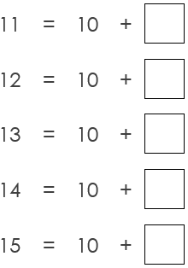
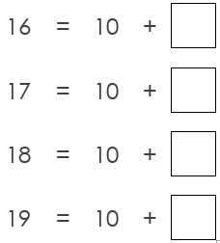
_____ is made of 10 and _____ ;
10 and _____ make _____ .
Mastering Number 2021/22 ncetm.org.uk

Slide 43
Session 4
Mastering Number 2021/22 ncetm.org.uk

Slide 44
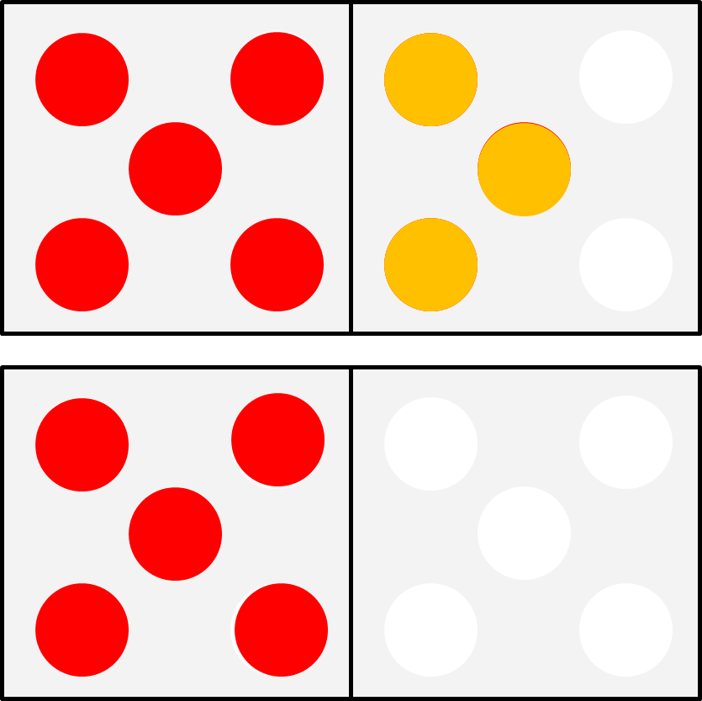
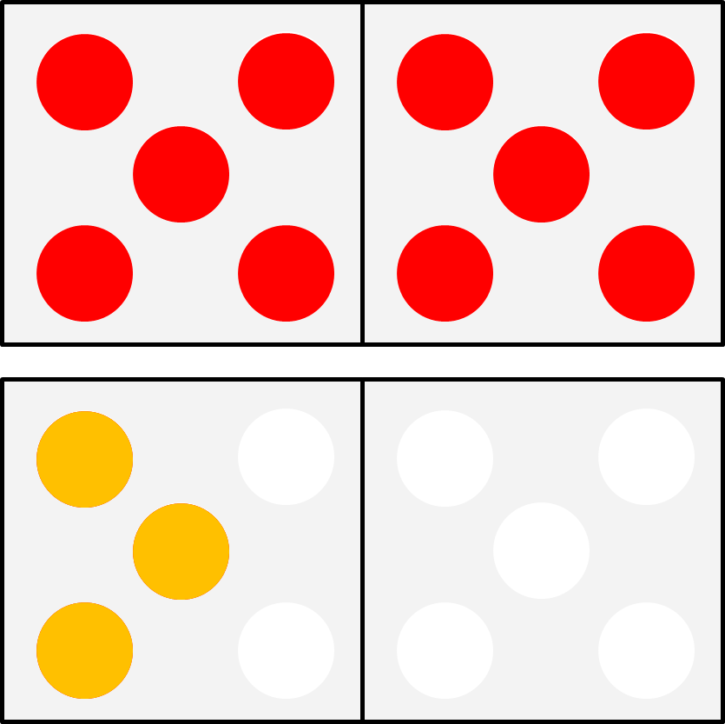
What is the same? What is different?
13
Thirteen
Mastering Number 2021/22 ncetm.org.uk

Slide 45
Guess the number your partner makes
Then, make the SAME number in a DIFFERENT way
11
12
13
14
15
Mastering Number 2021/22 ncetm.org.uk

Slide 46
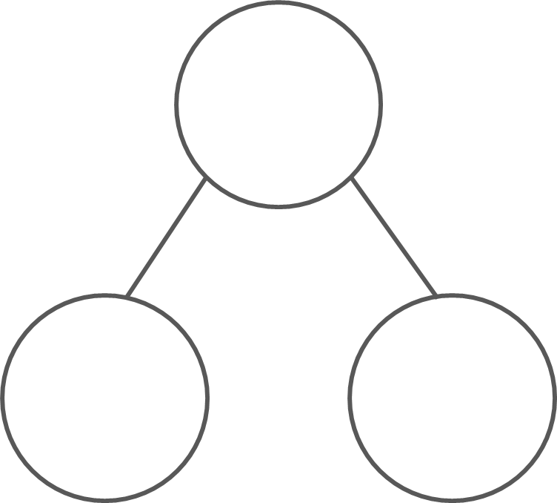
How can you represent this number in the part–part–whole diagram?
14
10
4
_____ can split into _____ and _____ ;
_____ and _____ combine to make _____ .
Mastering Number 2021/22 ncetm.org.uk

Slide 47
Find the missing part or the missing whole
14
16
12
10
4
10
6
2
10
13
17
15
3
10
10
7
5
10
_____ can split into _____ and _____ ;
_____ and _____ combine to make _____ .
Mastering Number 2021/22 ncetm.org.uk

Slide 48
Write equations to match the part–part–whole diagram
 | + |  | =
14
 | + |  | =
10
4
 | – |  | =
 | – |  | =
Mastering Number 2021/22 ncetm.org.uk

Slide 49
Any questions?
Feel free to explore the different resources we use in Mastering Number.
Take home the vocabulary sheet and help yourself to a Year 1 or 2 yearly overview so you can help support the key skills we are working on in school.

